Slide 1

ADVANCING BIRD IDENTIFICATION WITH DEEP LEARNING
Under the esteemed guidance of
Mr.CH. V. Murali Krishna
Assistant Professor & H.O.D
PRESENTED BY –
B. PAVAN KALYAN (20KN1A4407)
K. MOBEEN (20KN1A4417)
SK. SADIK (20KN1A4450)
P. VAMSI (20KN1A4435)
DEPARTMENT OF COMPUTER SCIENCE AND ENGINEERING-DATA SCIENCE
NRI INSTITUTE OF TECHNOLOGY
Autonomous
(Approved by AICTE, Permanently Affiliated to JNTUK, Kakinada) Accredited by NBA (CSE, ECE & EEE), Accredited by NAAC with ‘A’ GradeISO 9001: 2015 Certified Institution Pothavarappadu (V), (Via) Nunna, Agiripalli (M), Krishna Dist, PIN: 521212, A.P, India.
2023-2024

Slide 2
ADVANCING BIRD IDENTIFICATION WITH DEEP LEARNING

Slide 3
Agenda
Abstract
Introduction
Literature Review
Motivation
Problem Statement
Proposed Methodology
Hardware & Software Requirements
Methodology & Architecture
Data Collection
Data Preprocessing
Results
Conclusion
Future works
References
Publication

Slide 4
Abstract

Slide 5
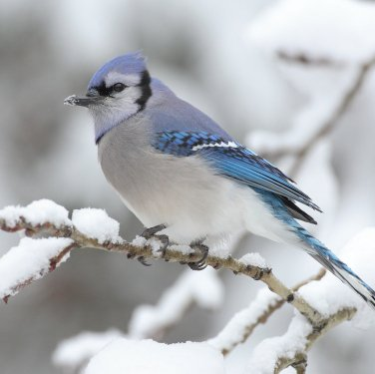
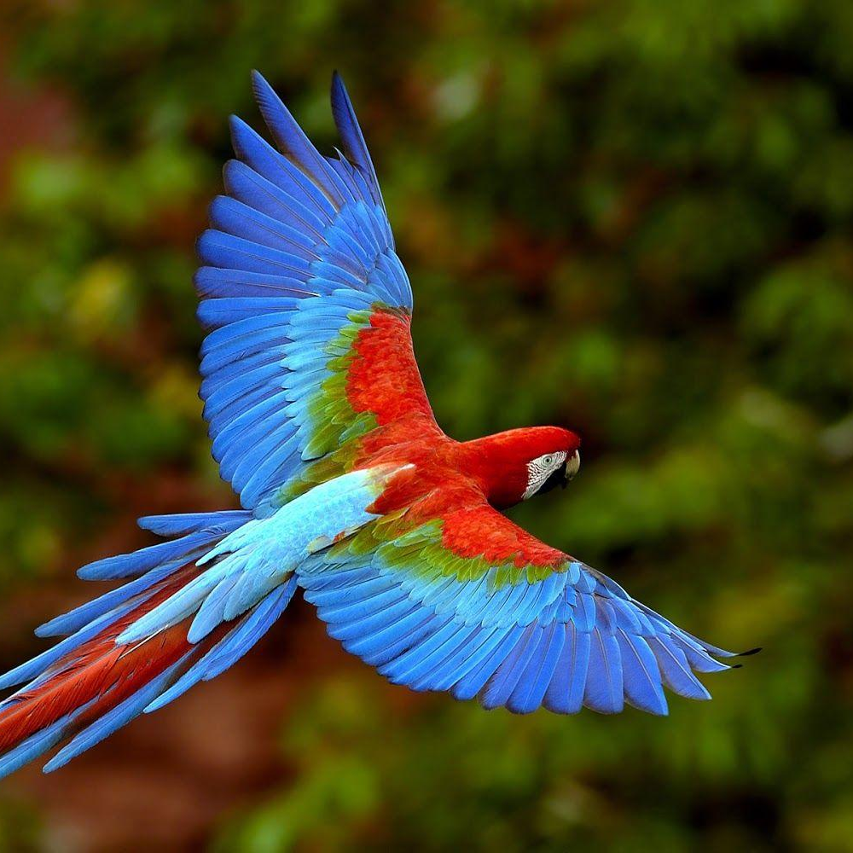
Abstract
This project addresses the decline in bird sightings in urban areas due to extinction and endangerment. It proposes a CNN model based on Inception V3 and transfer learning to identify bird species using the Kaggle-525 Bird Species dataset. Fine-tuning techniques are employed for hyperparameter adjustment and layer freezing. The model achieves 97.94% training accuracy and 91.39% testing accuracy. This approach aims to enhance bird species identification amid habitat loss and anthropogenic threats, crucial for biodiversity monitoring.

Slide 6
Introduction

Slide 7
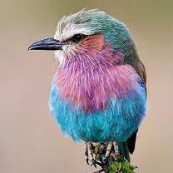
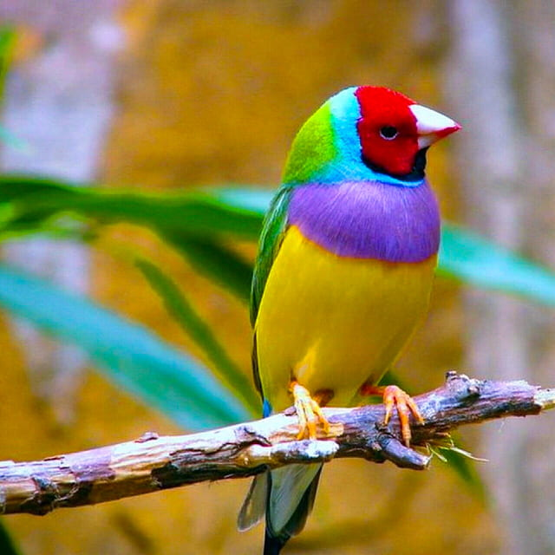
Introduction
Recent years have witnessed a surge in leveraging deep learning techniques, particularly convolutional neural networks (CNNs), by environmental researchers. This paper explores the application of CNNs in ecology, specifically for the intricate task of bird species classification. Birds, integral to ecosystems, pose challenges in identification due to diverse appearances and environmental variables. Our work employs CNNs based on Inception V3 to address these challenges, enhancing bird species classification and contributing to advancements in environmental research and conservation efforts.

Slide 8
Literature Review

Slide 9
Literature Review
Color-Based Features: This literature emphasizes the importance of color-based features, like mean, standard deviation, and skewness of RGB planes, for bird species classification.
SVM Algorithm: SVM algorithms are explored for feature extraction and classification, often paired with fast detection models like SDD.
Machine Learning Approaches: Literature reviews machine learning methods, like VGG-16 and MobileNet, for identifying birds in specific regions (Bangladesh and India).
Parallel Processing and GPU Technology: Efficient bird image identification is achieved through parallel processing, GPU technology, and frameworks like GoogleNet.
Artificial Neural Networks: Literature explores the application of artificial neural networks, specifically MLP, for classifying bird species based on selected shape, color, and texture features.

Slide 10
Motivation

Slide 11
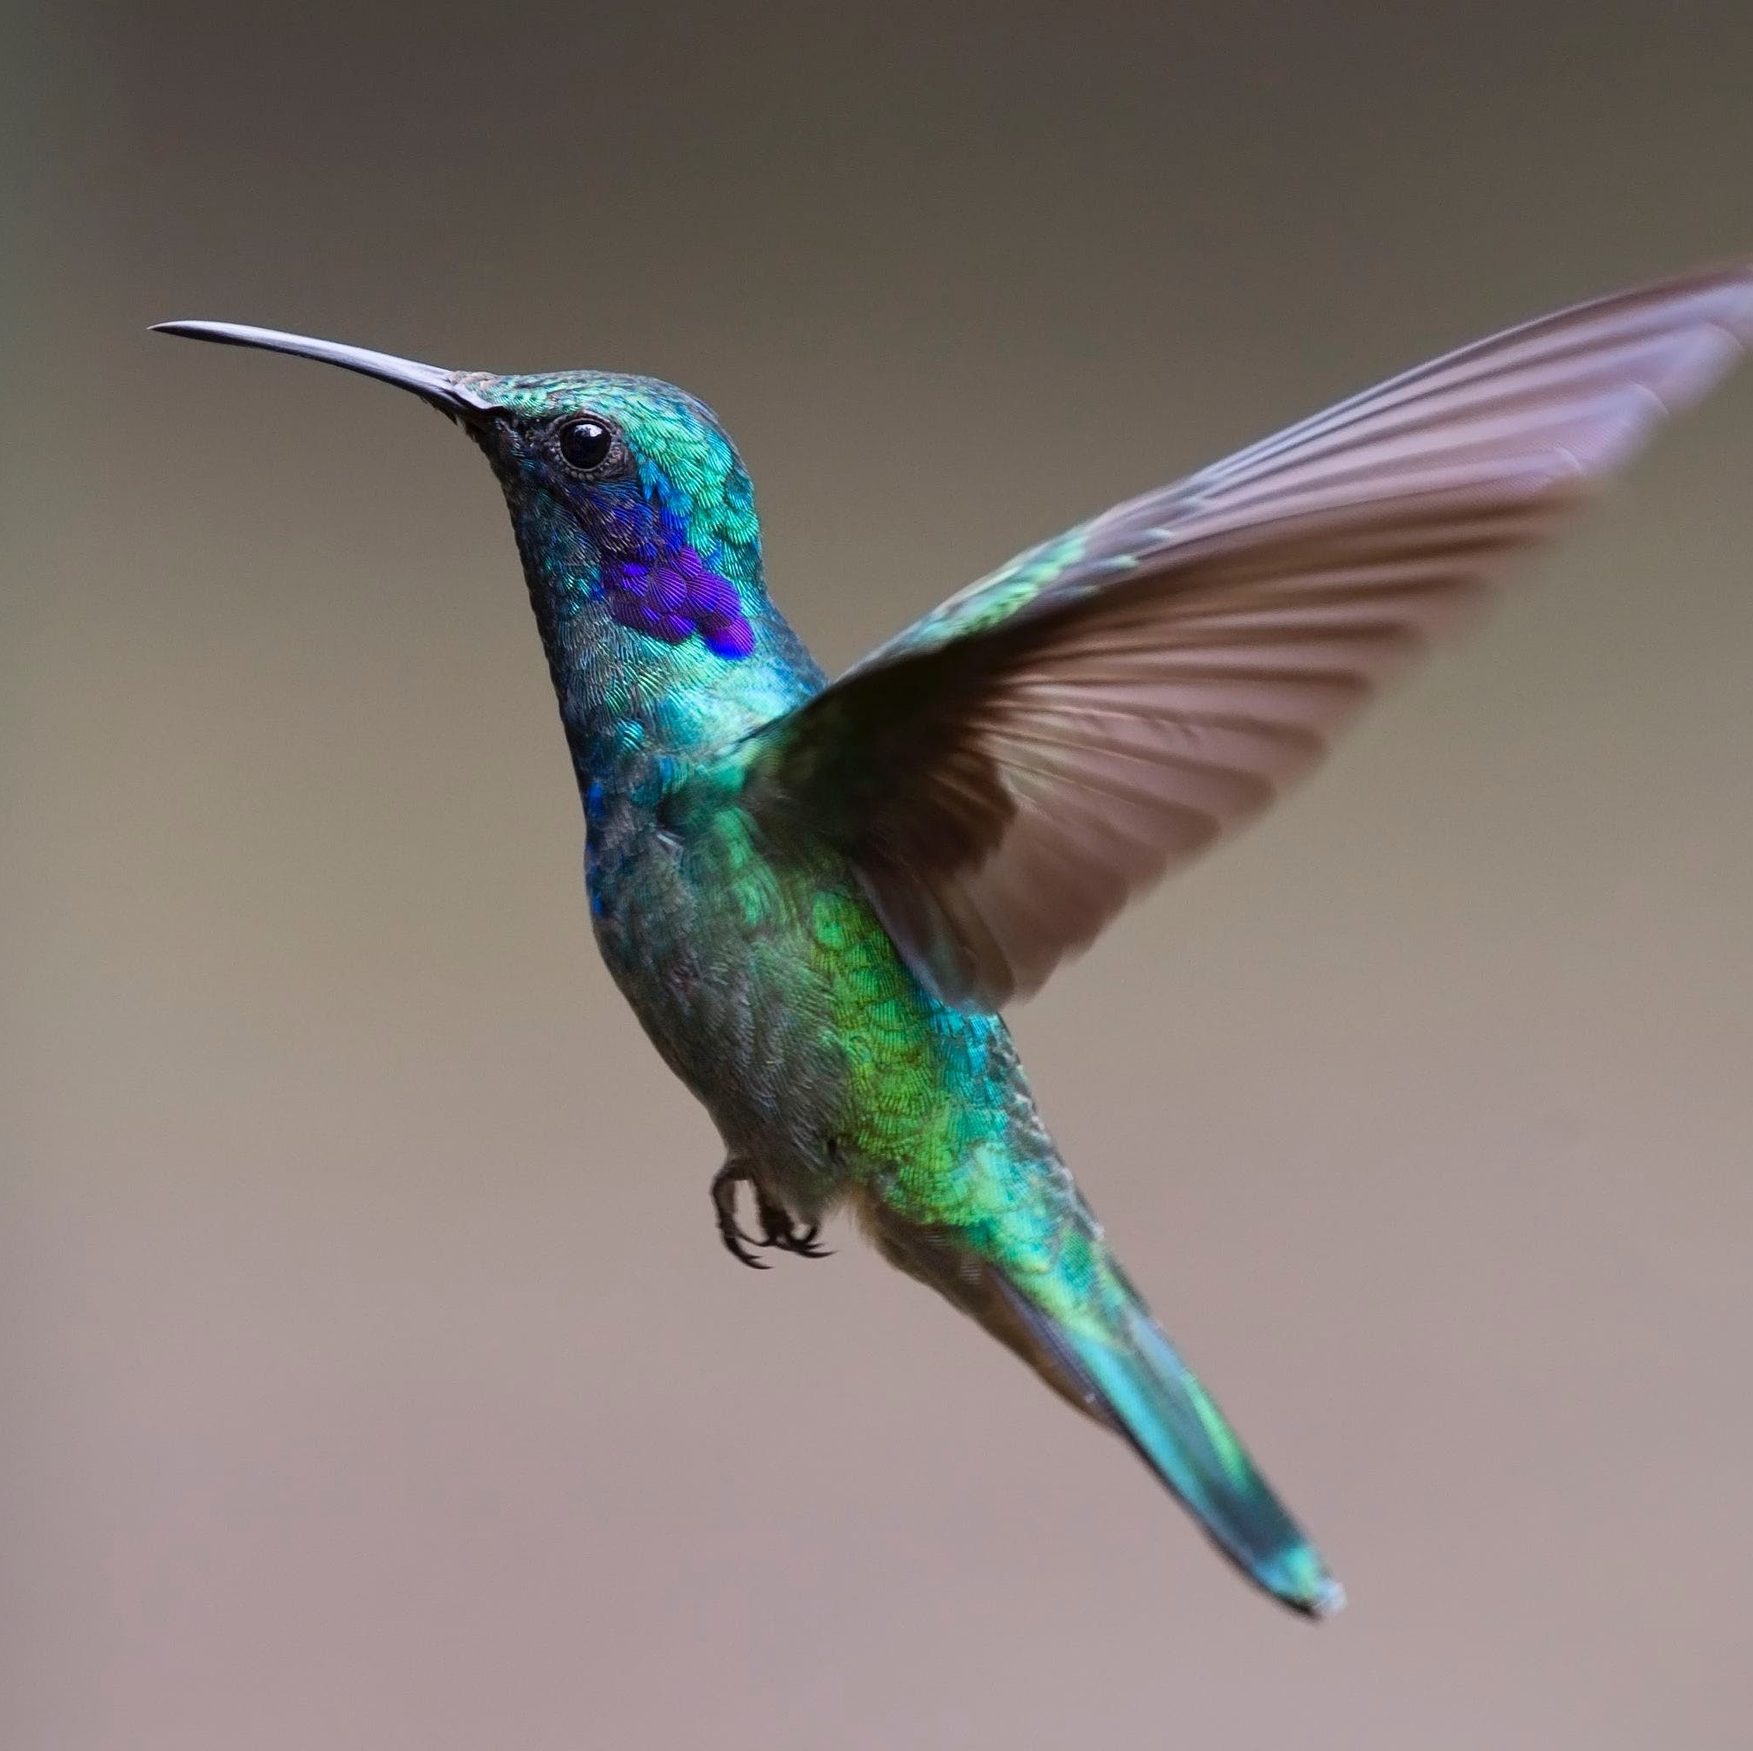
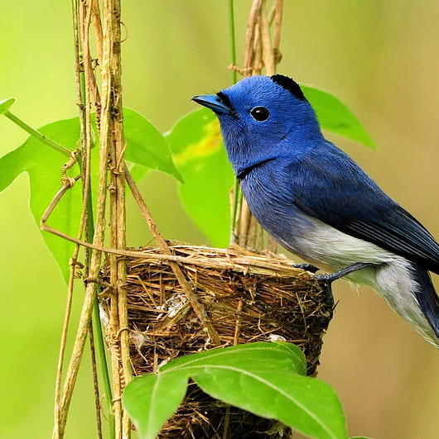
Motivation
The decline of bird species in urban areas due to extinction and habitat loss is alarming. Recognizing the urgency of conserving biodiversity, this paper proposes a cutting-edge solution leveraging computer vision and deep learning techniques. By developing a transfer learning-based CNN model, it aims to enhance the identification of bird species, crucial for biodiversity monitoring and conservation efforts. Utilizing the Kaggle-525 Bird Species dataset, the model achieves promising accuracy rates, offering hope for effective species recognition despite challenges like varied backgrounds and angles. This innovative approach holds promise in mitigating the threat to avian diversity and restoring balance to ecosystems.

Slide 12
Problem Statement

Slide 13
Motivation
This study employs a novel deep learning approach utilizing Convolutional Neural Networks (CNN) for the identification of bird species. CNNs, comprising input, convolution, ReLU, pooling, and fully connected layers, excel in image processing. The convolutional layer extracts features, the pooling layer reduces feature map dimensions, and the fully-connected layer processes flattened output. This methodology leverages the power of CNNs to automate image processing, specifically focusing on RGB combinations for accurate bird species identification.

Slide 14
Proposed Methodology

Slide 15
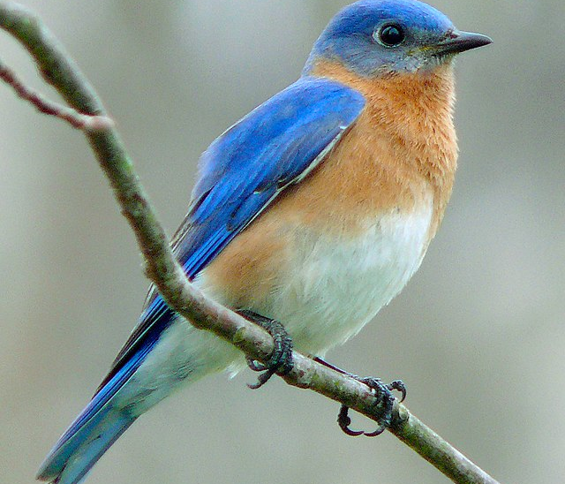
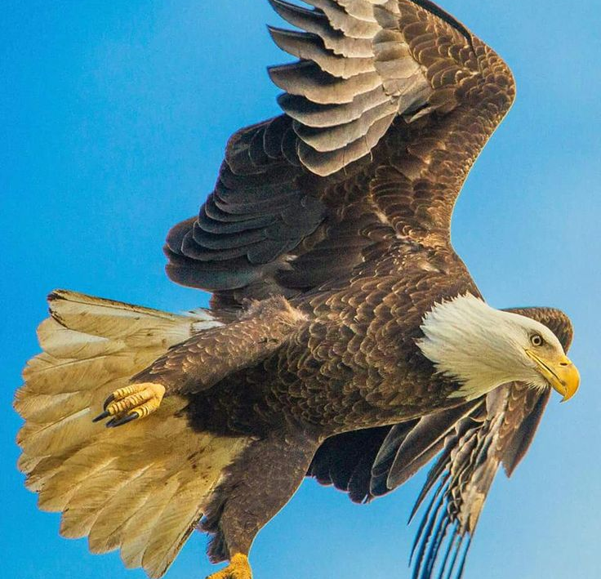
Summary
In conclusion, this study demonstrates the efficacy of CNNs for automated bird species identification, utilizing powerful layers for feature extraction and classification. The proposed methodology enhances image processing, showcasing the potential of deep learning algorithms in advancing bird species recognition.

Slide 16
Thank you

